Slide 1
Part I: Translating & Starting a Program: Compiler, Linker, Assembler, Loader
Part II: Basic Arithmetic
Morteza Nikooghadam
Chapter 4

Slide 2
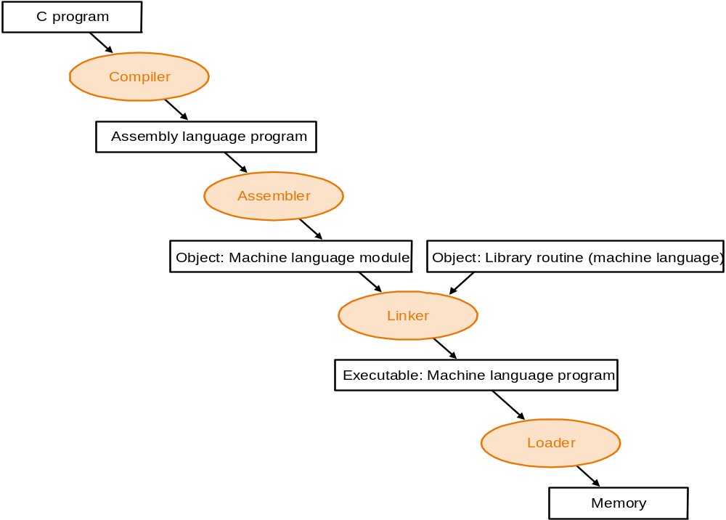
Program Translation Hierarchy
Translating & Starting a Program

Slide 3
System Software for Translation
Compiler: takes one or more source programs and converts them to an assembly program
Assembler: takes an assembly program and converts it to machine code
  An object file (or a library)
Linker: takes multiple object files and libraries, decides memory layout and resolves references to convert them to a single program
  An executable (or executable file)
Loader: takes an executable, stores it in memory, initializes the segments and stacks, and jumps to the initial part of the program
  The loader also calls exit once the program completes
Translating & Starting a Program

Slide 4
Translation Hierarchy
Compiler
  Translates high-level language program into assembly language
Assembler
  Converts assembly language programs into object files
    Object files contain a combination of machine instructions, data, and information needed to place instructions properly in memory
Translating & Starting a Program

Slide 5
Symbolic Assembly Form
<Label> <Mnemonic> <OperandExp> … <OperandExp> <Comment>
Loop: slti $t0, $s1, 100 # set $t0 if $s1<100
Label: optional
  Location reference of an instruction
  Often starts in the 1st column and ends with “:”
Mnemonic: symbolic name for operations to be performed
  Arithmetic, data transfer, logic, branch, etc
OperandExp: value or address of an operand
Comments: Don’t forget me! ☺
Translating & Starting a Program
Notes:
which directs assembler to

Slide 6
MIPS Assembly Language
Refer to MIPS instruction set at the back of your textbook
Pseudo-instructions
  Provided by assembler but not implemented by hardware
  Disintegrated by assembler to one or more instructions
  Example:
  blt $16, $17, Less ➔ slt $1, $16, $17
  bne $1, $0, Less
Translating & Starting a Program

Slide 7
MIPS Directives
Special reserved identifiers used to communicate instructions to the assembler
  Begin with a period character
  Technically are not part of MIPS assembly language
Examples:
.data # mark beginning of a data segment
.text # mark beginning of a text(code) segment
.space # allocate space in memory
.byte # store values in successive bytes
.word # store values in successive words
.align # specify memory alignment of data
.asciiz # store zero-terminated character sequences
Translating & Starting a Program
Notes:
Tells assembler how to interpret or where to put code; no machine code is generated
str1: .ascii “I am a string”
str2: .asciiz “I am a null-terminated string”
.align 2: word alignment
Just instructions to the assembler to take actions

Slide 8
MIPS Hello World
# PROGRAM: Hello World!
.data # Data declaration section
out_string: .asciiz “\nHello, World!\n”
.text # Assembly language instructions
main:
li $v0, 4 # system call code for printing string = 4
la $a0, out_string # load address of string to print into $a0
syscall # call OS to perform the operation in $v0
A basic example to show
  Structure of an assembly language program
  Use of label for data object
  Invocation of a system call
Translating & Starting a Program

Slide 9
Assembler
Convert an assembly language instruction to a machine language instruction
  Fill the value of individual fields
Compute space for data statements, and store data in binary representation
Put information for placing instructions in memory – see object file format
Example: j loop
  Fill op code: 00 0010
  Fill address field corresponding to the local label loop
Question:
  How to find the address of a local or an external label?
Translating & Starting a Program

Slide 10
Local Label Address Resolution
Assembler reads the program twice
  First pass: If an instruction has a label, add an entry <label, instruction address> in the symbol table
  Second pass: if an instruction branches to a label, search for an entry with that label in the symbol table and resolve the label address; produce machine code
Assembler reads the program once
  If an instruction has an unresolved label, record the label and the instruction address in the backpatch table
  After the label is defined, the assembler consults the backpatch table to correct all binary representation of the instructions with that label
External label? – need help from linker!
Translating & Starting a Program
Notes:
Produce machine code

Slide 11
Object File Format
O
b
j
e
c
t
f
i
l
e
T
e
x
t
D
a
t
a
R
e
l
o
c
a
t
i
o
n
S
y
m
b
o
l
D
e
b
u
g
g
i
n
g
h
e
a
d
e
r
s
e
g
m
e
n
t
s
e
g
m
e
n
t
i
n
f
o
r
m
a
t
i
o
n
t
a
b
l
e
i
n
f
o
r
m
a
t
i
o
n
Six distinct pieces of an object file for UNIX systems
Object file header
  Size and position of each piece of the file
Text segment
  Machine language instructions
Data segment
  Binary representation of the data in the source file
  Static data allocated for the life of the program
Translating & Starting a Program

Slide 12
Object File Format
O
b
j
e
c
t
f
i
l
e
T
e
x
t
D
a
t
a
R
e
l
o
c
a
t
i
o
n
S
y
m
b
o
l
D
e
b
u
g
g
i
n
g
h
e
a
d
e
r
s
e
g
m
e
n
t
s
e
g
m
e
n
t
i
n
f
o
r
m
a
t
i
o
n
t
a
b
l
e
i
n
f
o
r
m
a
t
i
o
n
Relocation information
  Identifies instruction and data words that depend on the absolute addresses
  In MIPS, only lw/sw and jal needs absolute address
Symbol table
  Remaining labels that are not defined
    Global symbols defined in the file
    External references in the file
Debugging information
  Symbolic information so that a debugger can associate machine instructions with C source files
Translating & Starting a Program

Slide 13
Example Object Files
Object file header
 | Name | Procedure A
 | Text Size | 0x100
 | Data size | 0x20
Text Segment | Address | Instruction
 | 0 | lw $a0, 0($gp)
 | 4 | jal 0
 | … | …
Data segment | 0 | (X)
 | … | …
Relocation information | Address | Instruction Type | Dependency
 | 0 | lw | X
 | 4 | jal | B
Symbol Table | Label | Address
 | X | –
 | B | –
Translating & Starting a Program

Slide 14
Program Translation Hierarchy
Translating & Starting a Program

Slide 15
Linker
Why a linker? Separate compilation is desired!
  Retranslation of the whole program for each code update is time consuming and a waste of computing resources
  Better alternative: compile and assemble each module independently and link the pieces into one executable to run
A linker/link editor “stitches” independent assembled programs together to an executable
  Place code and data modules symbolically in memory
  Determine the addresses of data and instruction labels
  Patch both the internal and external references
    Use symbol table in all files
    Search libraries for library functions
Translating & Starting a Program
Notes:
Assign address to data and instruction in all files
Place data and text segments of a file relative to other files
Determine size of text and data segments for the program

Slide 16
Producing an Executable File
S
o
u
r
c
e
A
s
s
e
m
b
l
e
r
O
b
j
e
c
t
f
i
l
e
f
i
l
e
S
o
u
r
c
e
A
s
s
e
m
b
l
e
r
O
b
j
e
c
t
E
x
e
c
u
t
a
b
l
e
f
i
l
e
f
i
l
e
L
i
n
k
e
r
f
i
l
e
S
o
u
r
c
e
A
s
s
e
m
b
l
e
r
O
b
j
e
c
t
P
r
o
g
r
a
m
f
i
l
e
f
i
l
e
l
i
b
r
a
r
y
Translating & Starting a Program

Slide 17
Linking Object Files – An Example
Object file header
 | Name | Procedure A
 | Text Size | 0x100
 | Data size | 0x20
Text Segment | Address | Instruction
 | 0 | lw $a0, 0($gp)
 | 4 | jal 0
 | … | …
Data segment | 0 | (X)
 | … | …
Relocation information | Address | Instruction Type | Dependency
 | 0 | lw | X
 | 4 | jal | B
Symbol Table | Label | Address
 | X | –
 | B | –
Translating & Starting a Program

Slide 18
The 2nd Object File
Object file header
 | Name | Procedure B
 | Text Size | 0x200
 | Data size | 0x30
Text Segment | Address | Instruction
 | 0 | sw $a1, 0($gp)
 | 4 | jal 0
 | … | …
Data segment | 0 | (Y)
 | … | …
Relocation information | Address | Instruction Type | Dependency
 | 0 | lw | Y
 | 4 | jal | A
Symbol Table | Label | Address
 | Y | –
 | A | –
Translating & Starting a Program

Slide 19
Solution
Executable file header
 | Text size | 0x300
 | Data size | 0x50
Text segment | Address | Instruction
 | 0x0040 0000 | lw $a0, 0x8000($gp)
 | 0x0040 0004 | jal 0x0040 0100
 | … | …
 | 0x0040 0100 | sw $a1, 0x8020($gp)
 | 0x0040 0104 | jal 0x0040 0000
 | … | …
Data segment | Address
 | 0x1000 0000 | (x)
 | … | …
 | 0x1000 0020 | (Y)
 | … | …
.text segment from procedure A
.data segment from procedure A
$gp has a default position
Translating & Starting a Program

Slide 20
Dynamically Linked Libraries
Disadvantages of statically linked libraries
  Lack of flexibility: library routines become part of the code
  Whole library is loaded even if all the routines in the library are not used
    Standard C library is 2.5 MB
Dynamically linked libraries (DLLs)
  Library routines are not linked and loaded until the program is run
    Lazy procedure linkage approach: a procedure is linked only after it is called
  Extra overhead for the first time a DLL routine is called + extra space overhead for the information needed for dynamic linking, but no overhead on subsequent calls
Translating & Starting a Program
Notes:
-, program has to be re-compiled in order to use newer versions of the libraries

Slide 21
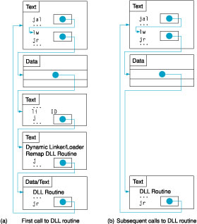
Dynamically Linked Libraries
Translating & Starting a Program

Slide 22
Program Translation Hierarchy
Translating & Starting a Program

Slide 23
Loader
A loader starts execution of a program
  Determine the size of text and data through executable’s header
  Allocate enough memory for text and data
  Copy data and text into the allocated memory
  Initialize registers
    Stack pointer
  Copy parameters to registers and stack
  Branch to the 1st instruction in the program
Translating & Starting a Program

Slide 24
Summary
Steps and system programs to translate and run a program
  Compiler
  Assembler
  Linker
  Loader
More details can be found in Appendix A of Patterson & Hennessy
Translating & Starting a Program

Slide 25
Part II: Basic Arithmetic
Lecture 4

Slide 26
RoadMap
Implementation of MIPS ALU
  Signed and unsigned numbers
  Addition and subtraction
  Constructing an arithmetic logic unit Multiplication
  Division
  Floating point
Next lecture
Translating & Starting a Program
Notes:
Implementing the MIPS ISA architecture

Slide 27
Review: Two's Complement
Negating a two's complement number: invert all bits and add 1
  2: 0000 0010
  -2: 1111 1110
Converting n bit numbers into numbers with more than n bits:
  MIPS 16 bit immediate gets converted to 32 bits for arithmetic
  Sign extension: copy the most significant bit (the sign bit) into the other bits
  0010 -> 0000 0010
  1010 -> 1111 1010
    Remember lbu vs. lb
Translating & Starting a Program
Notes:
remember: “negate” and “invert” are quite different!

Slide 28
Review: Addition & Subtraction
Just like in grade school (carry/borrow 1s)
0111 0111 0110
+ 0110 - 0110 - 0101
Two's complement makes operations easy
  Subtraction using addition of negative numbers
  7-6 = 7+ (-6) : 0111
  + 1010
Overflow: the operation result cannot be represented by the assigned hardware bits
  Finite computer word; result too large or too small
  Example: -8 <= 4-bit binary number <=7
  6+7 =13, how to represent with 4-bit?
Translating & Starting a Program

Slide 29
Detecting Overflow
No overflow when adding a positive and a negative number
  Sum is no larger than any operand
No overflow when signs are the same for subtraction
  x - y = x + (-y)
Overflow occurs when the value affects the sign
  Overflow when adding two positives yields a negative
  Or, adding two negatives gives a positive
  Or, subtract a negative from a positive and get a negative
  Or, subtract a positive from a negative and get a positive
Translating & Starting a Program

Slide 30
Effects of Overflow
An exception (interrupt) occurs
  Control jumps to predefined address for exception handling
  Interrupted address is saved for possible resumption
Details based on software system / language
Don't always want to detect overflow
  MIPS instructions: addu, addiu, subu
  Note: addiu still sign-extends!
Translating & Starting a Program
Notes:
Note: sltu, sltiu for unsigned comparisons

Slide 31
Review: Boolean Algebra & Gates
Basic operations
  AND, OR, NOT
Complicated operations
  XOR, NOR, NAND
Logic gates
  AND OR NOT
See details in Appendix B of textbook (on CD)
Translating & Starting a Program

Slide 32
Review: Multiplexor
Selects one of the inputs to be the output, based on a control input
MUX is needed for building ALU
S
Note: we call this a 2-input mux even though it has 3 inputs!
A
0
C
B
1
Translating & Starting a Program

Slide 33
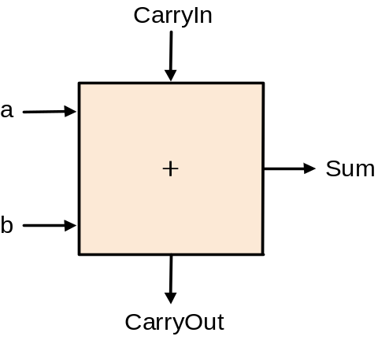
1-bit Adder
1-bit addition generates two result bits
  c_{out} = a.b + a.c_{in} + b.c_{in}
  sum = a xor b xor c_{in}
CarryIn
A
B
CarryOut
(3, 2) adder
Carryout part only
Translating & Starting a Program

Slide 34
Different Implementations for ALU
How could we build a 1-bit ALU for all three operations: add, AND, OR?
How could we build a 32-bit ALU?
Not easy to decide the “best” way to build something
  Don't want too many inputs to a single gate
  Don’t want to have to go through too many gates
  For our purposes, ease of comprehension is important
Translating & Starting a Program

Slide 35
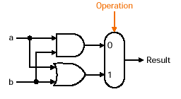
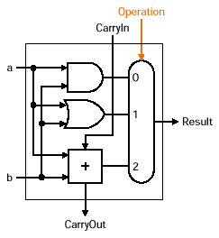
A 1-bit ALU
Design trick: take pieces you know and try to put them together
AND and OR
  A logic unit performing logic AND and OR
A 1-bit ALU that performs AND, OR, and addition
Translating & Starting a Program

Slide 36
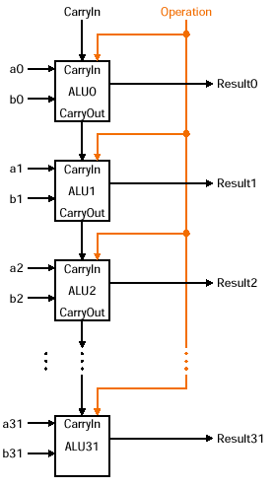
A 32-bit ALU, Ripple Carry Adder
A 32-bit ALU for AND,
OR and ADD operation:
connecting 32 1-bit ALUs
Translating & Starting a Program
Notes:
In order to build a 32-bit ALU, we simply connect 32 1-bit ALUs in series o feed the Carryout of one ALU to the Carry In of the next ALU

Slide 37
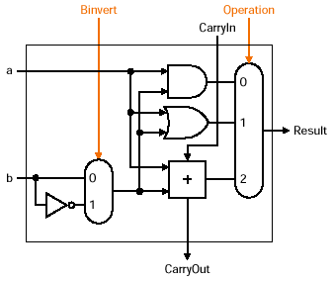
What About Subtraction?
Remember a-b = a+ (-b)
  Two’s complement of (-b): invert each bit (by inverter) of b and add 1
How do we implement?
  Bit invert: simple
  “Add 1”: set the CarryIn
Translating & Starting a Program

Slide 38
32-Bit ALU
MIPS instructions implemented
  AND, OR, ADD, SUB
Binvert
Translating & Starting a Program

Slide 39
Overflow Detection
Overflow occurs when
  Adding two positives yields a negative
  Or, adding two negatives gives a positive
In-class question:
Prove that you can detect overflow by
CarryIn31 xor CarryOut31
  That is, an overflow occurs if the CarryIn to the most significant bit is not the same as the CarryOut of the most significant bit
Translating & Starting a Program

Slide 40
Overflow Detection Logic
Overflow = CarryIn[N-1] XOR CarryOut[N-1]
CarryIn0
A0
1-bit
ALU
Result0
X
Y
X XOR Y
B0
CarryOut0
0
0
0
CarryIn1
A1
0
1
1
1-bit
ALU
Result1
1
0
1
B1
CarryOut1
1
1
0
CarryIn2
A2
1-bit
ALU
Result2
B2
CarryIn3
Overflow
A3
1-bit
ALU
Result3
B3
CarryOut3
Translating & Starting a Program
Notes:
Recall the XOR gate implements the not equal function: that is, its output is 1 only if the inputs have different values.
Therefore all we need to do is connect the carry into the most significant bit and the carry out of the most significant bit to the XOR gate.
Then the output of the XOR gate will give us the Overflow signal.
+1 = 42 min. (Y:22)

Slide 41
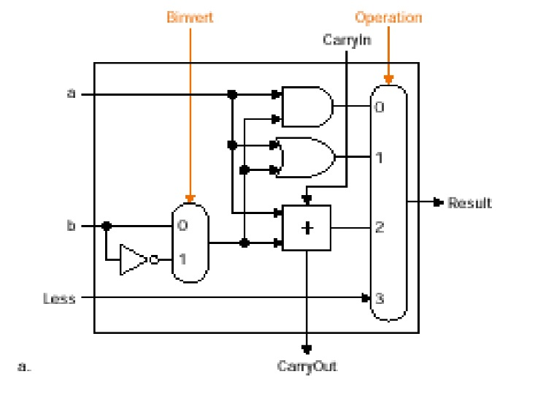
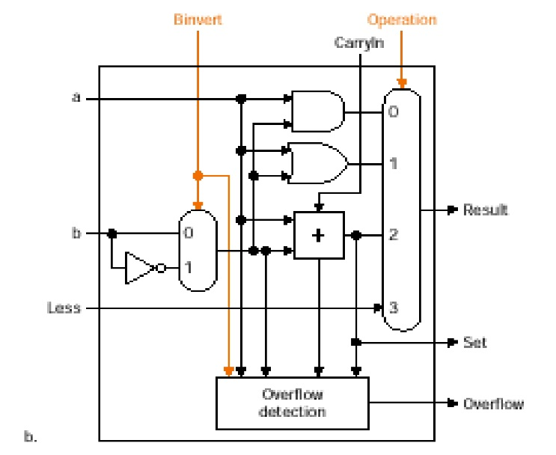
Set on Less Than Operation
slt $t0, $s1, $s2
  Set: set the value of least significant bit according to the comparison and all other bits 0
    Introduce another input line to the multiplexor: Less
    Less = 0→set 0; Less=1→set 1
  Comparison: implemented as checking whether ($s1-$s2) is negative or not
    Positive ($s1≥$s2): bit 31 =0;
    Negative($s1<$s2): bit 31=1
Implementation: connect bit 31 of the comparing result to Less input
Translating & Starting a Program

Slide 42
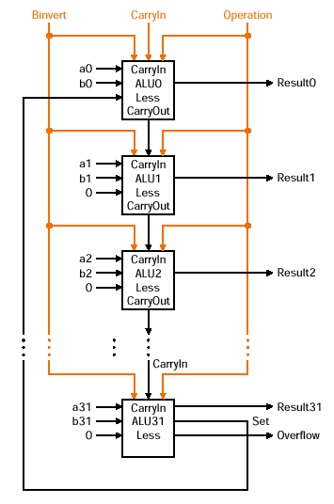
Set on Less Than Operation
Translating & Starting a Program

Slide 43
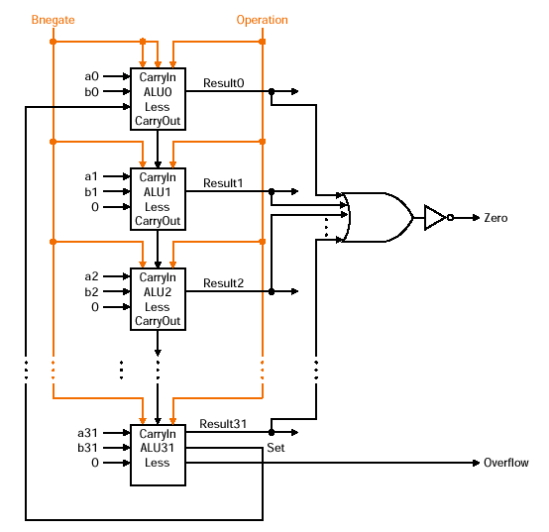
Conditional Branch
beq $s1,$s2,label
Idea:
  Compare $s1 an $s2 by checking whether ($s1-$s2) is zero
  Use an OR gate to test all bits
  Use the zero detector to decide branch or not
Translating & Starting a Program

Slide 44
A Final 32-bit ALU
Operations supported: and, or, nor, add, sub, slt, beq/bnq
ALU control lines: 2-bit operation control lines for AND, OR, add, and slt; 2-bit invert lines for sub, NOR, and slt
  See Appendix B.5 for details
ALU Control Lines | Function
0000 | AND
0001 | OR
0010 | Add
0110 | Sub
0111 1100 | Slt NOR
ALUop
4
A
32
Zero
ALU
Result
32
Overflow
B
32
CarryOut
Translating & Starting a Program

Slide 45
Ripple Carry Adder
Delay problem: carry bit may have to propagate from LSB to HSB
Design trick: take advantage of parallelism
  Cost: may need more hardware to implement
Translating & Starting a Program

Slide 46
Carry Lookahead
B1
A1
B0
A0
Cin1
Cin0
Cin2
1-bit
ALU
1-bit
ALU
Cout1
Cout0
CarryOut=(B•CarryIn)+(A•CarryIn)+(A•B)
  Cin2=Cout1= (B1 • Cin1)+(A1 • Cin1)+ (A1 • B1)
  Cin1=Cout0= (B0 • Cin0)+(A0 • Cin0)+ (A0 • B0)
Substituting Cin1 into Cin2:
  Cin2=(A1•A0•B0)+(A1•A0•Cin0)+(A1•B0•Cin0)
  +(B1•A0•B0)+(B1•A0•Cin0)+(B1•B0•Cin0)
  +(A1•B1)
  Now we can calculate CarryOut for all bits in parallel
Translating & Starting a Program
Notes:
Carry lookahead is another way to speed up an adder and here is the theory behind it.
Remember the logic equation for CarryOut so the carry coming out of bit 1 and into bit 2 (Cin2) looks like this.
Notice that, this carry will depends on the carry coming out of bit 0 (Cin1).
By substituting the equation of Cin1 into the equation Cin2, we can rewrite the equation of Cin2 so it depends on Cin0, A0, B0, A1, and B1.
The beauty of this equation is that it does NOT depend of the carry coming out of bit 0 (Cout0) so it does not have to wait for the carry to propagate through the lower bits.
This equation can be simplified if we redefine two terms: carry generate and propagate.
+2 = 55 min. (Y:35)

Slide 47
Carry-Lookahead
The concept of propagate and generate
  c(i+1)=(ai . bi) +(ai . ci) +(bi . ci)=(ai . bi) +((ai + bi) . ci)
  Propagate pi = ai + bi
  Generate gi = ai . bi
We can rewrite
  c1 = g0 + p0 . c0
  c2 = g1 + p1 . c1 = g1 + p1 . g0 +p1 . p0 . c0
  c3 = g2 + p2 . g1 + p2 . p1 . g0 + p2 . p1 . p0 . c0
Carry going into bit 3 is 1 if
  We generate a carry at bit 2 (g2)
  Or we generate a carry at bit 1 (g1) and
  bit 2 allows it to propagate (p2 * g1)
  Or we generate a carry at bit 0 (g0) and
  bit 1 as well as bit 2 allows it to propagate …..
Translating & Starting a Program
Notes:
First level of abstraction: pi, gi
Still too expensive! Why?
➔ still large number of gates
➔ How many gates are needed to compute
c1: c2: c3: c4:

Slide 48
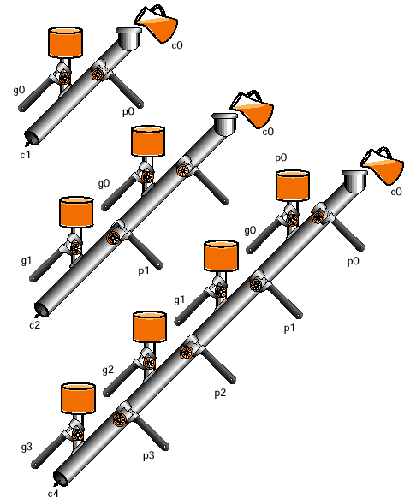
Plumbing Analogy
CarryOut is 1 if some earlier adder generates a carry and all intermediary adders propagate the carry
Translating & Starting a Program

Slide 49
Carry Look-Ahead Adders
Expensive to build a “full” carry lookahead adder
  Just imagine length of the equation for c31
Common practices:
  Consider an N-bit carry look-ahead adder with a small N as a building block
  Option 1: connect multiple N-bit adders in ripple carry fashion -- cascaded carry look-ahead adder
  Option 2: use carry lookahead at higher levels -- multiple level carry look-ahead adder
Translating & Starting a Program

Slide 50
Multiple Level Carry Lookahead
Where to get Cin of the block ?
  Generate “super” propagate Pi and “super” generate Gi for each block
    P0 = p3.p2.p1.p0
    G0 = g3 + (p3.g2) + (p3.p2.g1) + (p3.p2.p1.g0) + (p3.p2.p1.p0.c0) = cout3
  Use next level carry lookahead structure to generate Cin
A[15:12]
B[15:12]
A[11:8]
B[11:8]
A[7:4]
B[7:4]
A[3:0]
B[3:0]
4
4
4
4
4
4
4
4
C12
C8
C4
4-bit Carry
Lookahead
Adder
4-bit Carry
Lookahead
Adder
4-bit Carry
Lookahead
Adder
4-bit Carry
Lookahead
Adder
C0
4
4
4
4
Result[15:12]
Result[11:8]
Result[7:4]
Result[3:0]
Translating & Starting a Program
Notes:
As you can imagine from looking at the carry lookahead equations, it is very expensive if you want to build a full 32-bit carry lookahead adder: the equation for Cin31 will be very long.
A common practice is to build smaller N-bit carry lookahead adders and then connect them together to form a bigger adder.
For example, here we connect four 8-bit carry lookahead adders to form a 32-bit adder.
+1 = 57 min. (Y:37)

Slide 51
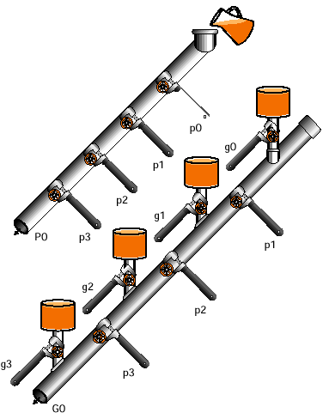
Super Propagate and Generate
A “super” propagate is true only if all propagates in the same group is true
A “super” generate is true only if at least one generate in its group is true and all the propagates downstream from that generate are true
Translating & Starting a Program

Slide 52
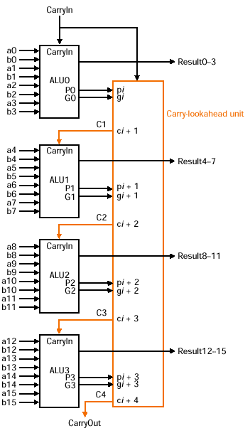
A 16-Bit Adder
Second-level of abstraction to use carry lookahead idea again
Give the equations for C1, C2, C3, C4?
  C1= G0 + (P0.c0)
  C2 = G1 + (P1.G0) + (P1.P0.c0)
  C3 and C4 for you to exercise
Translating & Starting a Program

Slide 53
An Example
Determine gi, pi, Gi, Pi, and C1, C2, C3, C4 for the following two 16-bit numbers:
a: 0010 1001 0011 0010
b: 1101 0101 1110 1011
Do it yourself
Translating & Starting a Program

Slide 54
Performance Comparison
Speed of ripple carry versus carry lookahead
  Assume each AND or OR gate takes the same time
  Gate delay is defined as the number of gates along the critical path through a piece of logic
  16-bit ripple carry adder
    Two gate per bit: c(i+1) = (ai.bi)+(ai+bi).ci
    In total: 2*16 = 32 gate delays
  16-bit 2-level carry lookahead adder
    Bottom level: 1 AND or OR gate for gi,pi
    Mid-level: 1 gate for Pi; 2 gates for Gi
    Top-level: 2 gates for Ci
    In total: 2+2+1 = 5 gate delays
  Your exercise: 16-bit cascaded carry lookahed adder?
Translating & Starting a Program

Slide 55
Summary
Traditional ALU can be built from a multiplexor plus a few gates that are replicated 32 times
  Combine simpler pieces of logic for AND, OR, ADD
To tailor to MIPS ISA, we expand the traditional ALU with hardware for slt, beq, and overflow detection
Faster addition: carry lookahead
  Take advantage of parallelism
Translating & Starting a Program

Slide 56
Next Lecture
Topic:
  Advanced ALU: multiplication and division
  Floating-point number
Translating & Starting a Program

